Slide 1
Pizza Vendor Review
Group 6
Mayank Badika
Ankur Maloo
Ananth Ramaswamy
Jorge Vargas
Guided By:
Professor CHONG OH

Slide 2
Website Overview
Review and advertisement for top 5 pizzeria vendors in Salt Lake City.
Provide vendor description and offers.
Redirect customer to the vendors main website to place order.
Login and register new customers.
Obtain customers comments, and feedback.

Slide 3
Website Benefit
Provides review content for the selective vendor.
Customers can write their reviews about their experiences with the vendors’ pizzas and offers.
Customers can find nearby pizzeria locations.
The website is user friendly, to select their favorite pizza company.

Slide 4
Website Demonstration
We will demonstrate to register new user.
Navigate through the website.
Add a review.
Update and Delete review.
Finally test the links to the vendors’ websites.

Slide 5
Website Code
PHP – The website contains: authentication, session, access to the database, and view information.
HTML & CSS – The HTML and CSS was used to create forms, and provide styling to the webpage.
MySQL – The website is retrieving all the data from MySQL.
JavaScript – We used JavaScript for form validation, at the new user registration and creation of review.

Slide 6
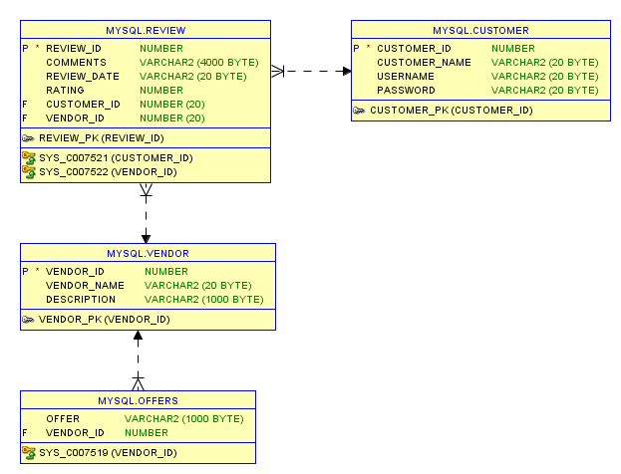
Website Database

Slide 7
Any Questions?

